Slide 1
Assessment of air quality associated with socioeconomic status in China
Wenyuan Cui & Hao Wu
Mechanical and Aerospace Engineering

Slide 2
Goal: find the cause of air pollution in China by analying air quality data
Outline:
Introduction
Data source and collection
Data manipulation and visualization
Regression analysis and Predictive modeling
Conclusion and Future Improvement

Slide 3

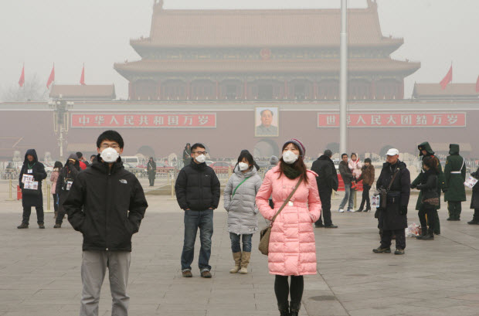
Introduction
What is air pollution and what causes it?
Air pollution can be defined as the presence of toxic chemicals such as PM2.5,PM10,CO,SO2,etc in the air
It is caused by human activities such as mining , industrial work, transportation, construction, etc.
Why the air quality analysis matters?
Environment is being polluted
Millions of people suffer from health risk due to air pollution
What benefits this project can provide to the society, organizations,
or individuals?
Provide insights into the air quality with GDP and energy consumption
It is useful for governments and environmental agencies to take measures
of protecting our environment

Slide 4
Data source and collection
The information of the data
  year: year of data in this row
  month: month of data in this row
  day: day of data in this row
  hour: hour of data in this row
  PM2.5: PM2.5 concentration (mg/m^3)
  PM2.5_24h: PM2.5 concentration 24 hourly average (mg/m^3)
  PM10: PM10 concentration (mg/m^3)
  PM10_24h: PM10 concentration 24 hourly average (mg/m^3)
  AQI: air quality index real time value
  SO2: sulfur dioxide real time concentration (mg/m^3)
  SO2_24h: sulfur dioxide 24 hourly average (mg/m^3)
  NO2: nitrogen dioxide real time concentration (mg/m^3)
  NO2_24h: nitrogen dioxide 24 hourly average (mg/m^3)
  O3: ozone real time concentration (mg/m^3)
  CO: carbon monoxide real time concentration (mg/m^3)
  CO_24h: carbon monoxide 24 hourly average(mg/m^3)
  DEWP: Dew Point (Celsius Degree)
  TEMP: Temperature (Celsius Degree)
  HUMI: Humidity (%)
  PRES: Pressure (hPa)
  cbwd: Combined wind direction
  Iws: Cumulated wind speed (m/s)
  The data source is measured from China National Environmental Monitoring Station of the national city air quality real-time release platform. The data was collected in five Chinese cities from 01/2015 to 12/2017

Slide 5
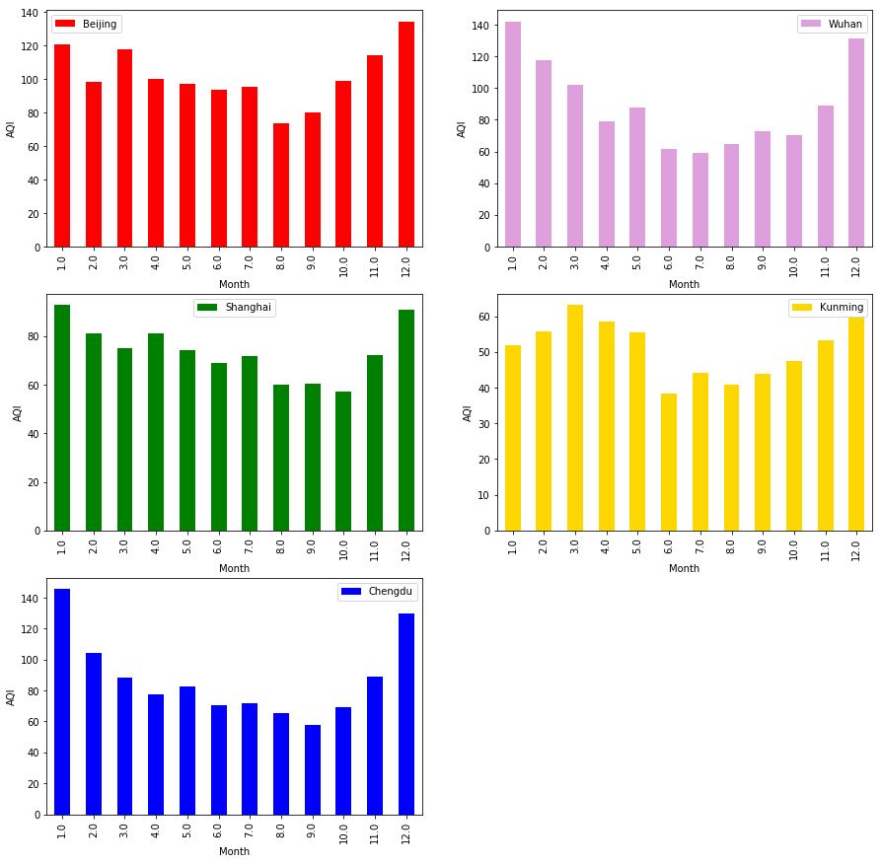
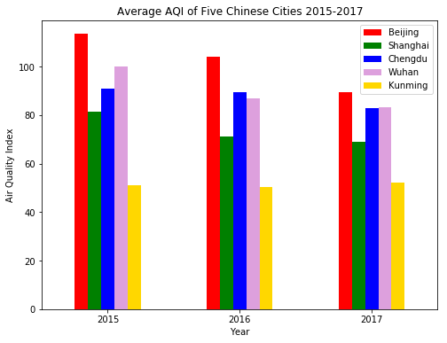
Data manipulation and visualization
Air quality index (AQI) across time
The overall AQI trend is decreasing for those five cities from 2015 to 2017.
Beijing air quality is the worst among the five cites and Kunming has the best air quality
Five cites show the same distribution which AQI is high in winter and low in summer

Slide 6
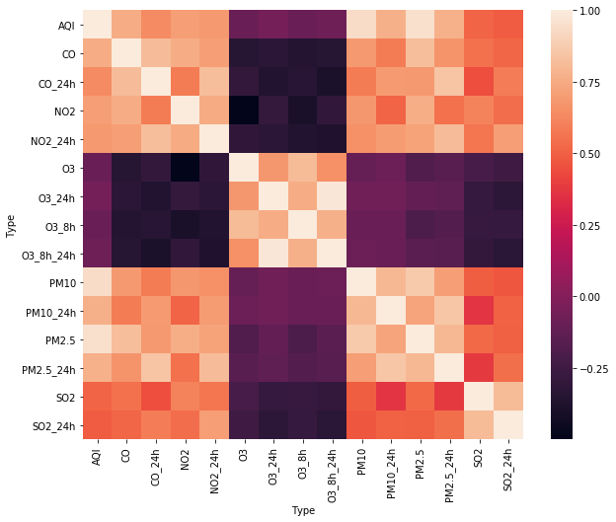
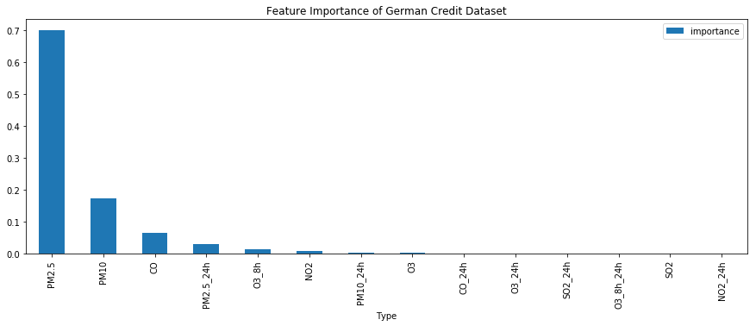
Table feature importance table
2) Correlation analysis and feature selection
Type | importance
PM2.5 | 0.698992
PM10 | 0.173087
CO | 0.066157
PM2.5_24h | 0.029023
O3_8h | 0.015163
NO2 | 0.007671
PM10_24h | 0.003801
O3 | 0.002417
CO_24h | 0.001291
O3_24h | 0.001087
SO2_24h | 0.000568
O3_8h_24h | 0.000474
SO2 | 0.000142
NO2_24h | 0.000126
Based on the feature selection, we can see that the important value of PM2.5 is the highest, PM10 ranks the second score of importance score, CO and O3 rank the 3rd and 4th important features. This result is consistent with the correlation analysis.

Slide 7
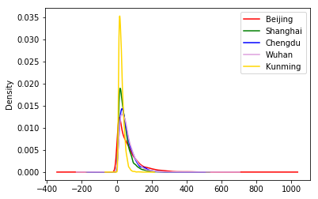
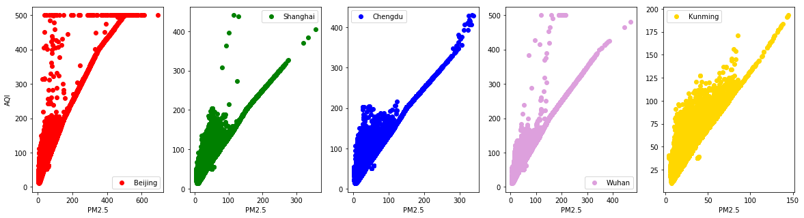
3) Review of PM2.5
The density plot presents the distribution of PM2.5 for five cities. It can tell that Beijing has the largest range of PM2.5, which means that the variance of PM2.5 is the highest. Shanghai and Kunming have more uniform density distribution of PM2.5 and the fluctuations are more stable.
AQI and PM2.5 have strong linear relationship in five cites

Slide 8
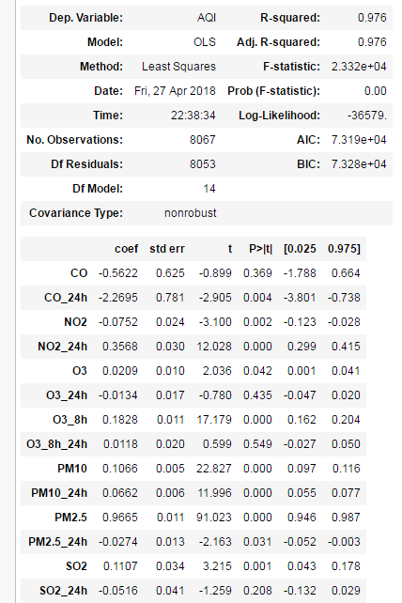
Regression analysis and Predictive modeling
1) Regression Analysis
CO, PM2.5 and CO_24h have a positive effect on Air Quality Index (AQI). Increasing 1 unit in CO concentration would increase AQI by 7.48 units after controlling for other factors. The positive effect of CO on AQI is statistically significant (P<0.001).
Predictors including CO_24h, O3 and PM10_24h do not have statistically significant effects on AQI (p-values > 0.05).

Slide 9
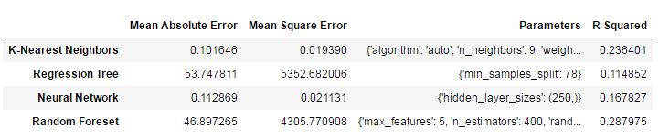
2) Predictive Modeling
Machine learning method to build model
  K-Nearest Neighbors
  Regression Tree
  Neural Network
  Random Foreset
Normalize data and split data into train dataset and test dataset
Create the design matrix
tune the parameters using the GridSearchCV
fit the model
use the best parameter to fit the model
predict our model using test dataset
3) Evaluation

Slide 10
Conclusion and Future Improvement
Conclusion
The overall air quality has been improved from 2015 to 2017. Summer time shows a better air quality among the four seasons.
Beijing has the worst air quality index while Kunming has the lowest air quality index in the past three years.
PM2.5, PM10 and CO concentration have the strong impact on the air quality index (AQI) based on the correlationship analysis and random forest feature selection.
According to the regression analysis, R squared value of the model is 0.989, which means a strong linear relationship between the AQI and other factors.
Prediction modeling utilizes the K-NN, regression tree, neural network and random forest algorithms to predict the AQI by weather factors. It shows that the random forest has the highest performance.

Slide 11
Future Improvement
The cause of air quality has been determined in this project. PM2.5, PM10 and CO concentrations
play a significant role in air quality. Some recommendation are as follows:
  Restrict the new cars growth
  Develop the environmental energy-efficient vehicles
  Shut down the polluting factories
  Reduce burning fossil fuels like coal.
The benefits of this project include:
  Find the cause of influencing the air quality by analyzing the data
  Provide the useful information to the government and environmental protection agency to
  conduct relative research
  Improve the lifehood of the people and reduce the risk of diabets, heart disearse and cancer

